Slide 1

SQL PROJECT
Finance Analytics,
Top Customers, Markets, Products

Slide 2
Project Overview
AtliQ Hardware is a global computer hardware manufacturer that specializes in producing high-performance computer components and peripherals.
The company operates across major international markets, including APAC (Asia-Pacific), EU (Europe), NA (North America), and LATAM (Latin America).
AtliQ’s product portfolio includes processors, motherboards, graphics cards, RAM, storage solutions (SSDs, HDDs), and peripherals such as keyboards, mice, and monitors.
With a commitment to innovation and quality, the company caters to both individual consumers and businesses, ensuring reliable and efficient hardware solutions for diverse computing needs.

Slide 3
Problem Statement
Performance Challenges with Large Excel Files – AtliQ Hardware is facing inefficiencies
and slow performance due to the increasing size of Excel files.
Expanding Data Analytics Team – To address this issue, the company is hiring junior data analysts to strengthen its data analytics capabilities.
Transition to MySQL – AtliQ is utilizing MySQL as its database management system to analyze data, track financial trends, and extract meaningful insights.
Business Optimization Goals – The project aims to enhance decision-making, streamline operations, and improve overall company performance.

Slide 4
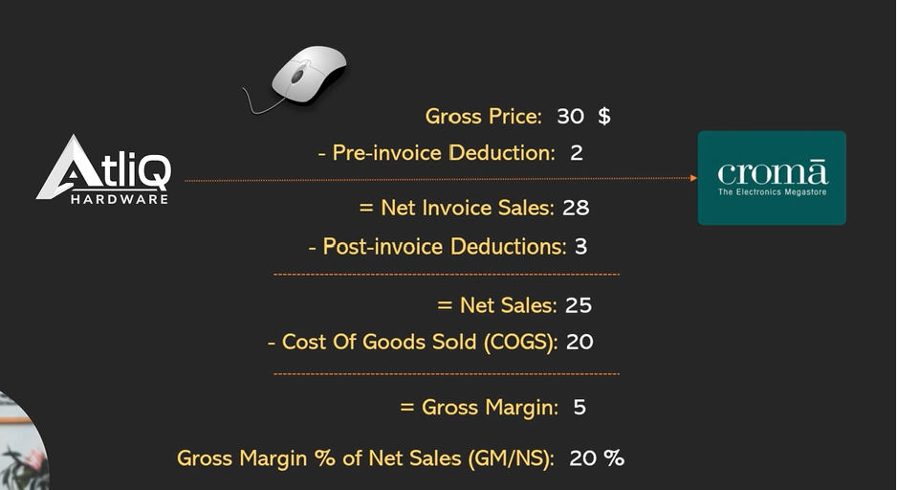
P & L statement

Slide 5
Task - 1
In order to track individual product sales and perform additional product analytics on it using Excel, I, as the product owner, would like to create a report of Croma India customers' sales of individual products (aggregated monthly at the product code level) for FY-2021. The following fields should be included in the report:
1. Month
2. Product Name
3. Variant
4. Sold Quantity
5. Gross Price Per Item
6. Gross Price Tota1

Slide 6
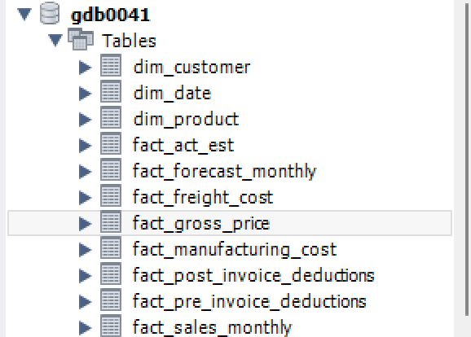
DataSet
Loaded a million rows of data into a MYSQL database and executed multiple queries.
Analyzed the following tables to derive the SQL concepts presented.

Slide 7
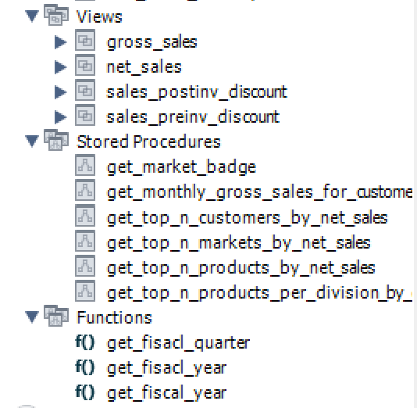
Functions Created
1.Views
2.Stored Procedure
3.Functions

Slide 8
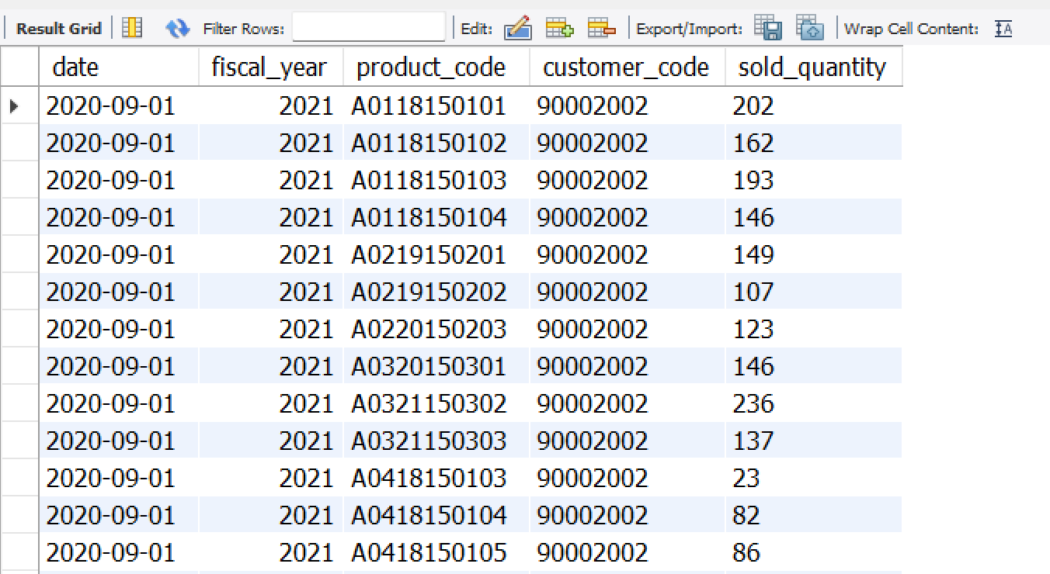
Finance Analytics
A. First grab customer codes for Croma india Query: SELECT * FROM dim_customer WHERE customer like "%croma%" AND market=“India";
B. Get all the sales transaction data from fact_sales_monthly table for that customer(croma: 90002002) in the fiscal_year 2021. Query: SELECT * FROM fact_sales_monthly WHERE customer_code=90002002 AND YEAR(DATE_ADD(date, INTERVAL 4 MONTH))=2021 ORDER BY date asc LIMIT 100000;

Slide 9
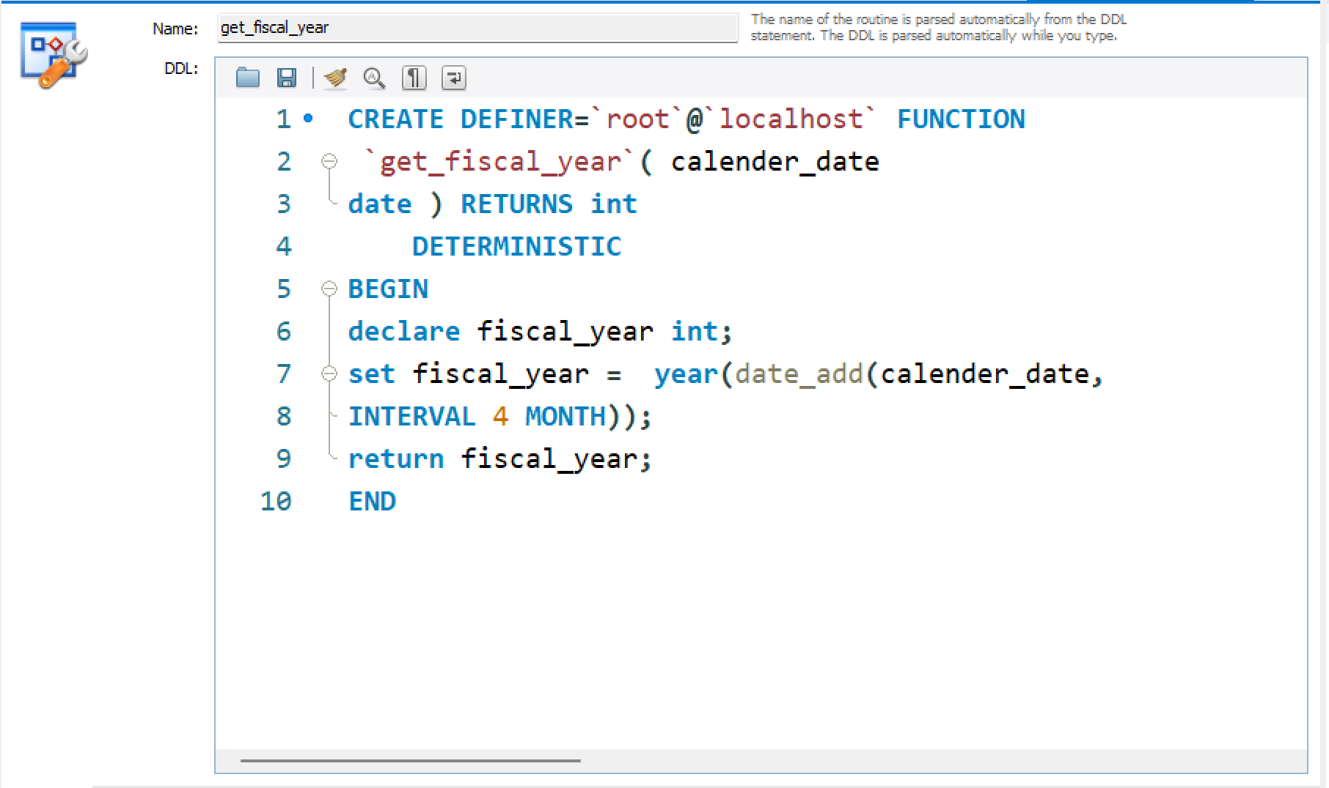
C. create a function 'get_fiscal_year' to get fiscal year by passing the date
CREATE FUNCTION `get_fiscal_year`(calendar_date DATE) RETURNS int DETERMINISTIC BEGIN DECLARE fiscal_year INT; SET fiscal_year = YEAR
(DATE_ADD(calendar_date,
INTERVAL 4 MONTH)); RETURN fiscal_year; END

Slide 10
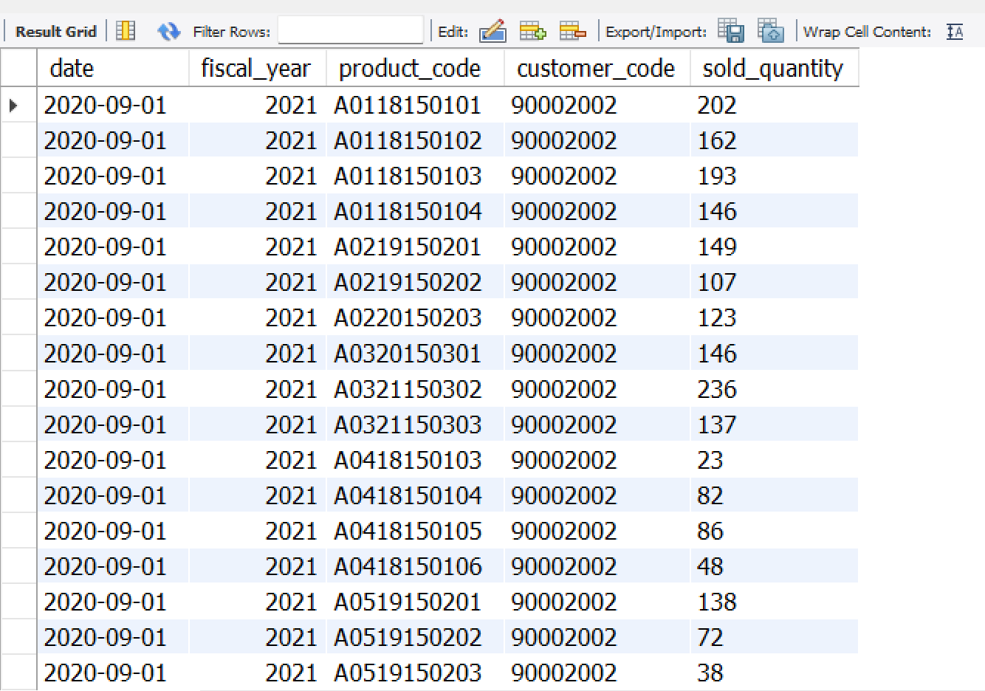
D . Replacing the function created in the step:b Query: SELECT * FROM fact_sales_monthly WHERE customer_code=90002002 AND get_fiscal_year(date)=2021 ORDER BY date asc LIMIT 100000;

Slide 11
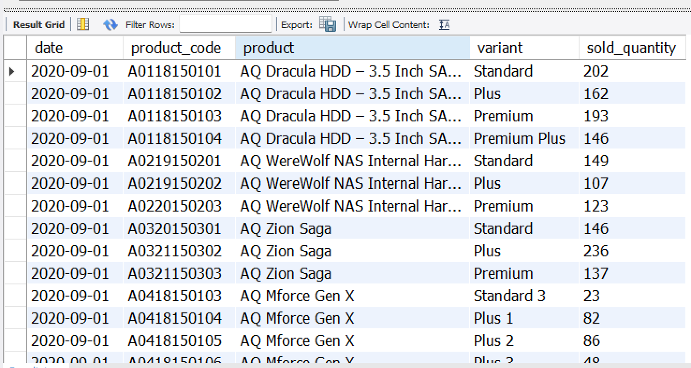
❑ Module: Gross Sales Report: Monthly Product Transactions
A. Perform joins to pull product information
SELECT s.date, s.product_code, p.product, p.variant, s.sold_quantity FROM fact_sales_monthly s JOIN dim_product p ON s.product_code=p.product_code WHERE customer_code=90002002 AND get_fiscal_year(date)=2021 LIMIT 1000000;

Slide 12
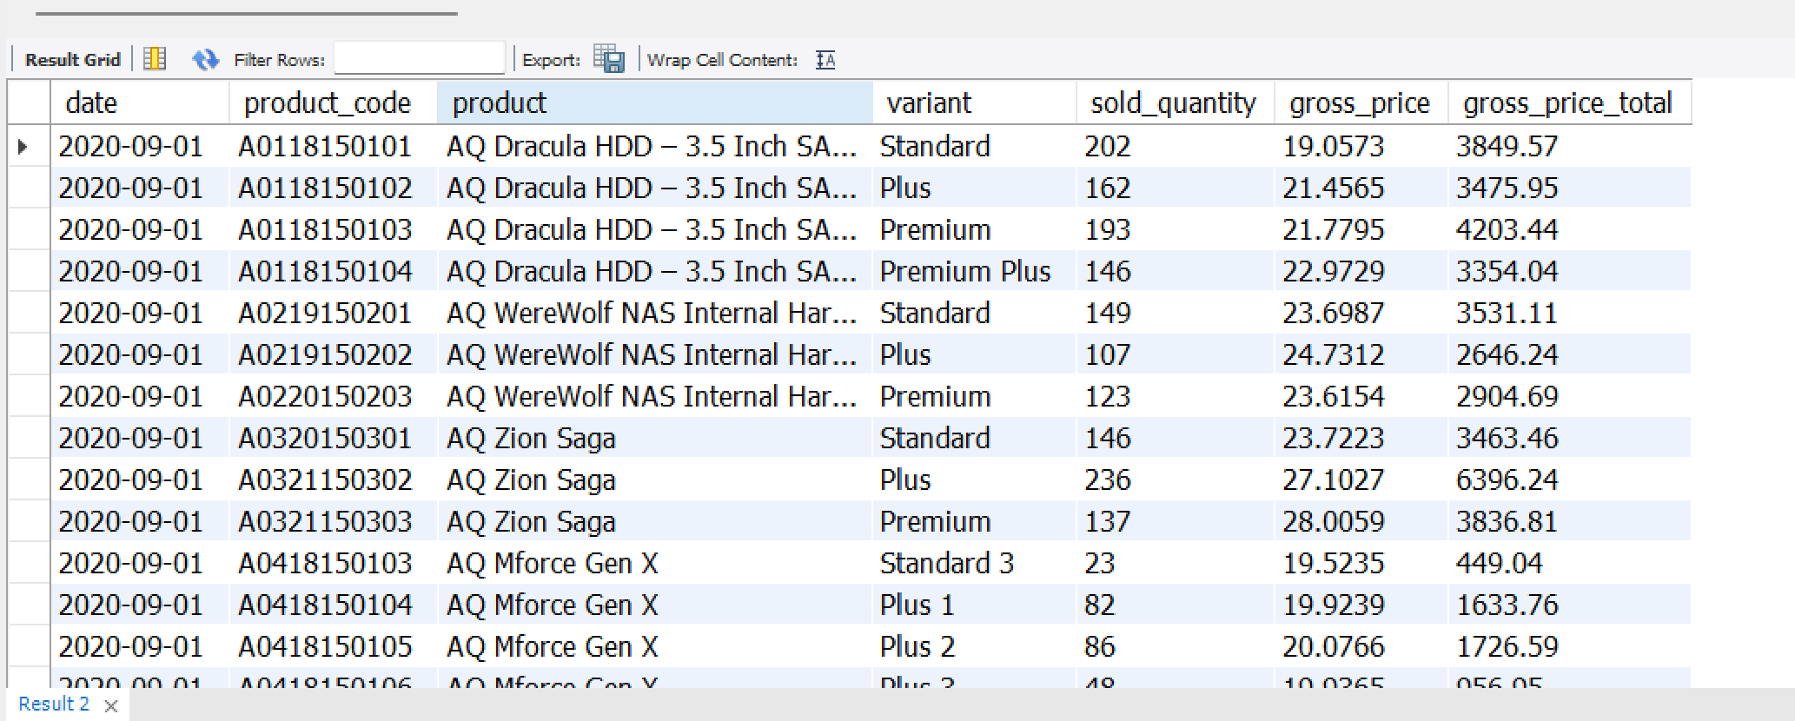
B. Performing join with 'fact_gross_price' table with the above query and generating required fields
SELECT s.date, s.product_code, p.product, p.variant, s.sold_quantity, g.gross_price, ROUND(s.sold_quantity*g.gross_price,2) as gross_price_total FROM fact_sales_monthly s JOIN dim_product p ON s.product_code=p.product_code JOIN fact_gross_price g ON g.fiscal_year=get_fiscal_year(s.date) AND g.product_code=s.product_code WHERE customer_code=90002002 AND get_fiscal_year(s.date)=2021 LIMIT 1000000;

Slide 13
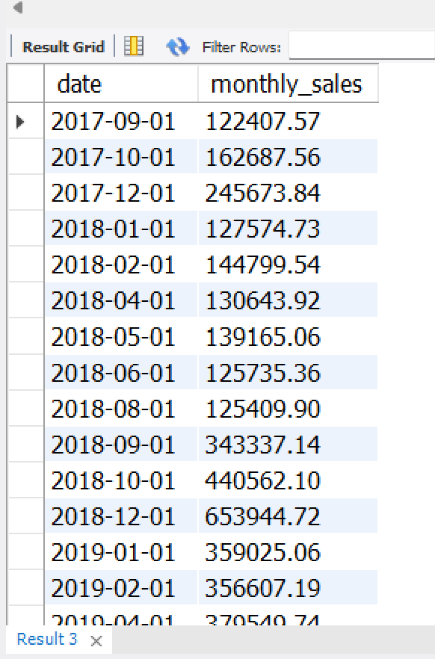
❑ Module: Gross Sales Report: Total Sales Amount
Generate monthly gross sales report for Croma India for all the years
SELECT s.date, SUM(ROUND(s.sold_quantity*g.gross_price,2)) as monthly_sales FROM fact_sales_monthly s JOIN fact_gross_price g ON g.fiscal_year=get_fiscal_year(s.date) AND g.product_code=s.product_code WHERE customer_code=90002002 GROUP BY date;

Slide 14
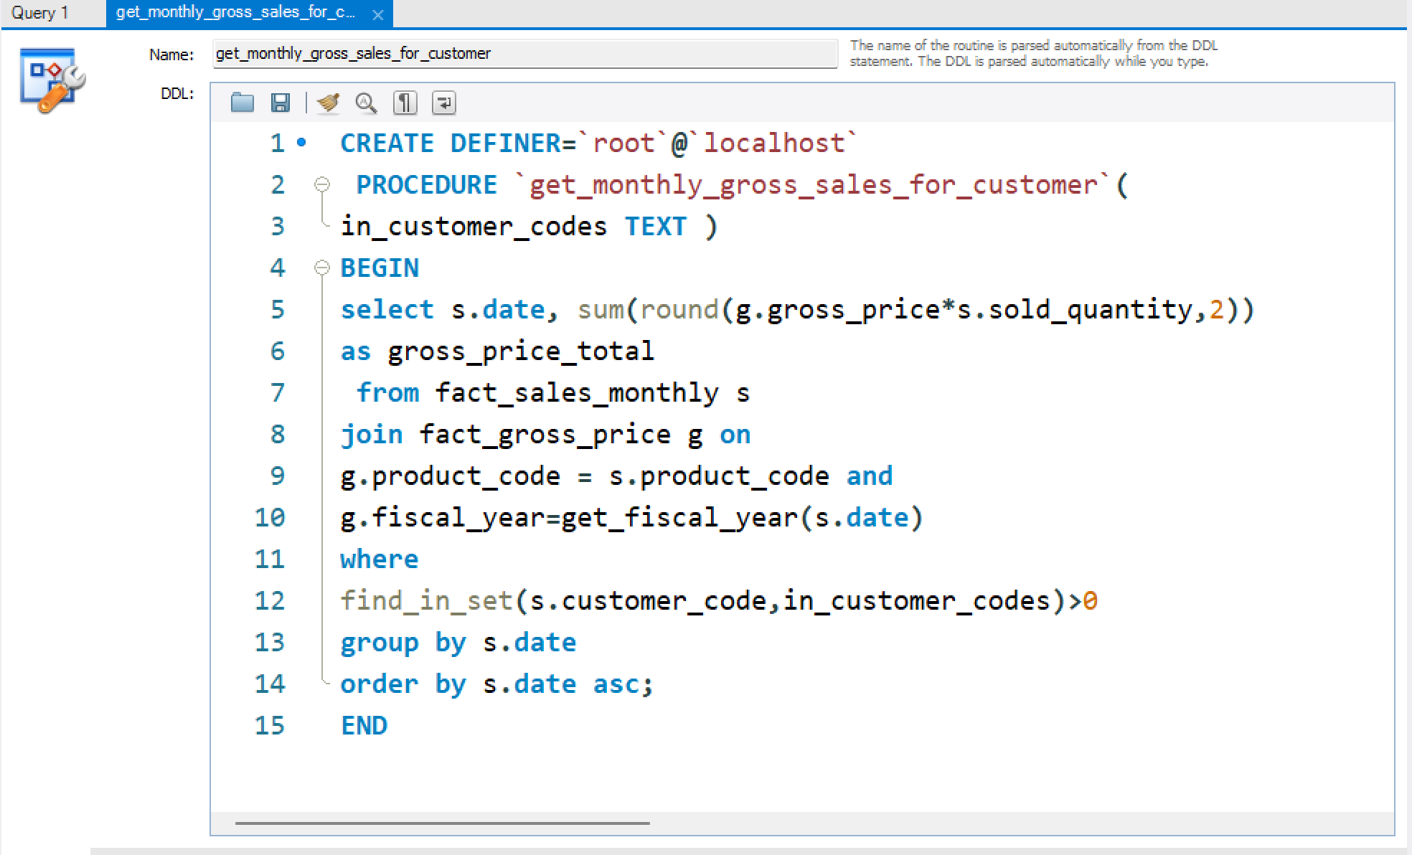
❑ Module: Stored Procedures: Monthly Gross Sales Report Generate monthly
Gross sales report for any customer using stored procedure

Slide 15
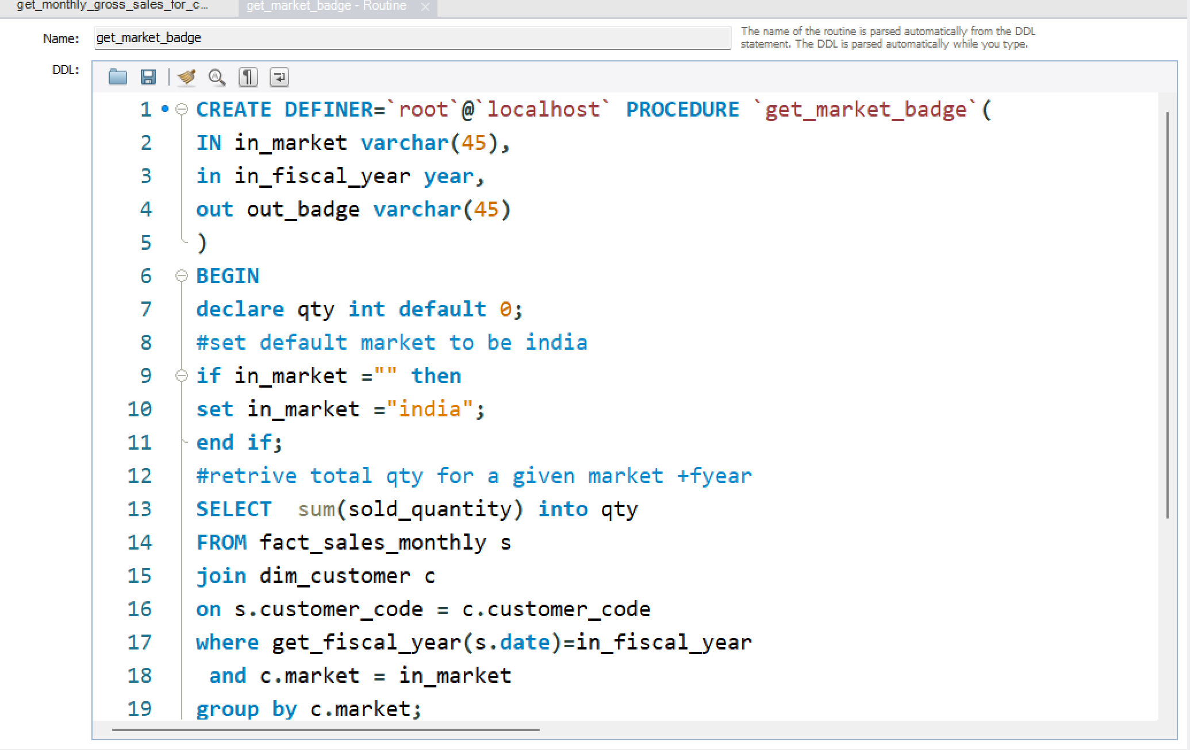
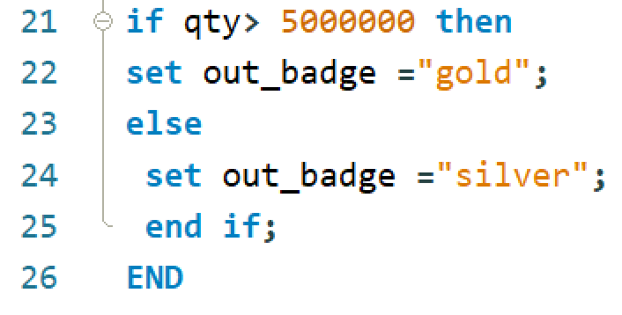
❑ Module: Stored Procedure: Market Badge

Slide 16
Top Customers, Products, Markets
Task :- 2 1. Report For Top market 2. Report for Top products 3. Report for Top customers

Slide 17
❑ Module: Problem Statement and Pre-Invoice Discount Report
Include pre-invoice deductions in Croma detailed report
→ SELECT s.date, s.product_code, p.product, p.variant, s.sold_quantity, g.gross_price as gross_price_per_item,
ROUND(s.sold_quantity*g.gross_price,2) as gross_price_total, pre.pre_invoice_discount_pct
FROM fact_sales_monthly s JOIN dim_product p
ON s.product_code=p.product_code JOIN fact_gross_price g
ON g.fiscal_year=get_fiscal_year(s.date)
AND g.product_code=s.product_code
JOIN fact_pre_invoice_deductions as pre ON pre.customer_code = s.customer_code AND pre.fiscal_year=get_fiscal_year(s.date) WHERE s.customer_code=90002002 AND get_fiscal_year(s.date)=2021 LIMIT 1000000;

Slide 18
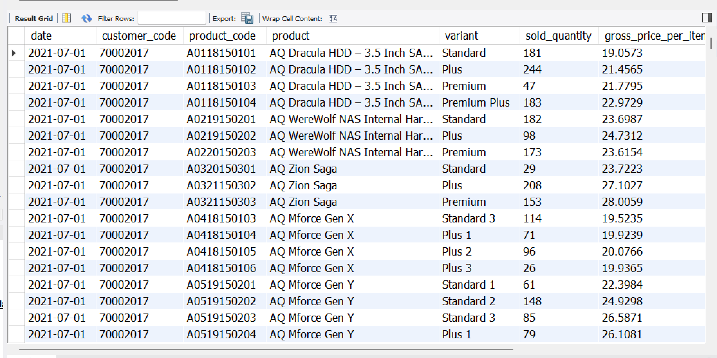
❑Module: Performance Improvement # 1
creating dim_date and joining with this table and avoid using the function 'get_fiscal_year()' to reduce the amount of time taking to run the query SELECT
s.date,
s.customer_code,
s.product_code,
p.product, p.variant,
s.sold_quantity,
g.gross_price as gross_price_per_item,
ROUND(s.sold_quantity*g.gross_price,2) as gross_price_total,
pre.pre_invoice_discount_pct
FROM fact_sales_monthly s
JOIN dim_date dt
ON dt.calendar_date = s.date
JOIN dim_product p ON s.product_code=p.product_code
JOIN fact_gross_price g
ON g.fiscal_year=dt.fiscal_year
AND g.product_code=s.product_code
JOIN fact_pre_invoice_deductions as pre
ON pre.customer_code = s.customer_code AND
pre.fiscal_year=dt.fiscal_year
WHERE
dt.fiscal_year=2021
LIMIT 1000000

Slide 19
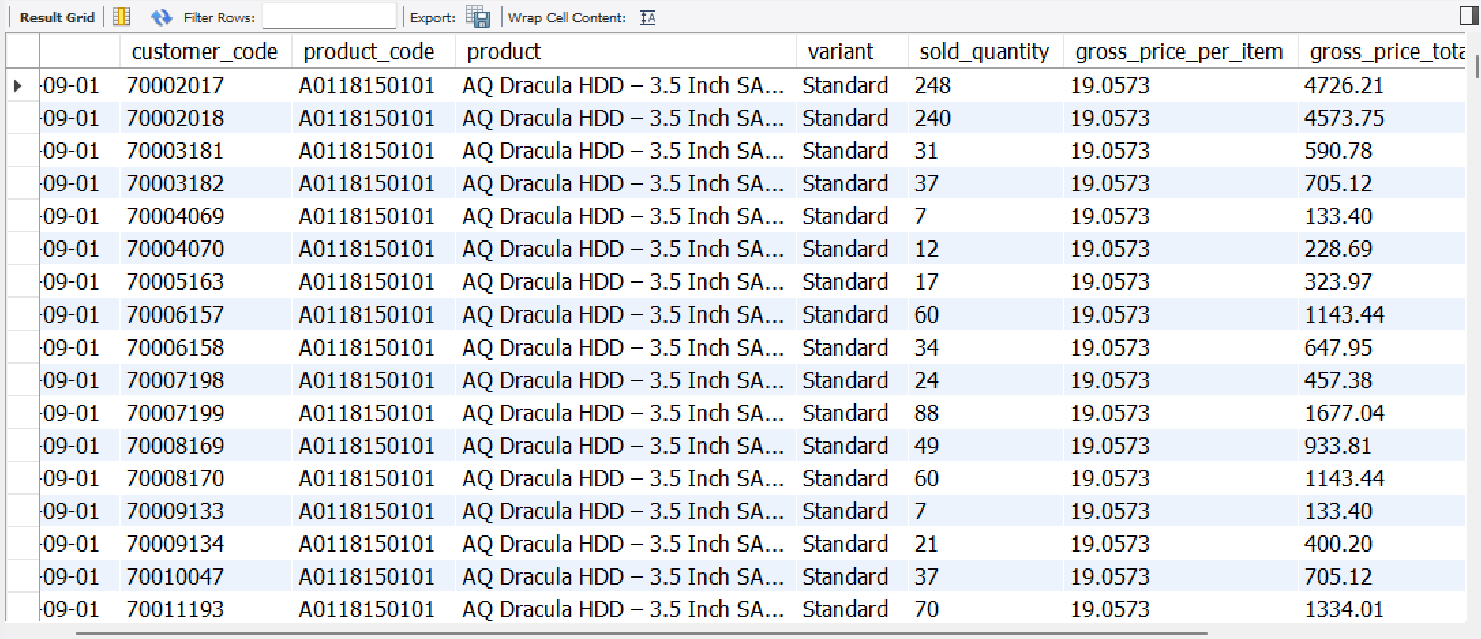
❑Module: Performance Improvement # 2
Added the fiscal year in the fact_sales_monthly table itself SELECT
s.date,
s.customer_code,
s.product_code,
p.product, p.variant,
s.sold_quantity,
g.gross_price as gross_price_per_item,
ROUND(s.sold_quantity*g.gross_price,2) as gross_price_total,
pre.pre_invoice_discount_pct
FROM fact_sales_monthly s
JOIN dim_product p
ON s.product_code=p.product_code
JOIN fact_gross_price g
ON g.fiscal_year=s.fiscal_year
AND g.product_code=s.product_code
JOIN fact_pre_invoice_deductions as pre
ON pre.customer_code = s.customer_code AND
pre.fiscal_year=s.fiscal_year
WHERE
s.fiscal_year=2021
LIMIT 1500000

Slide 20
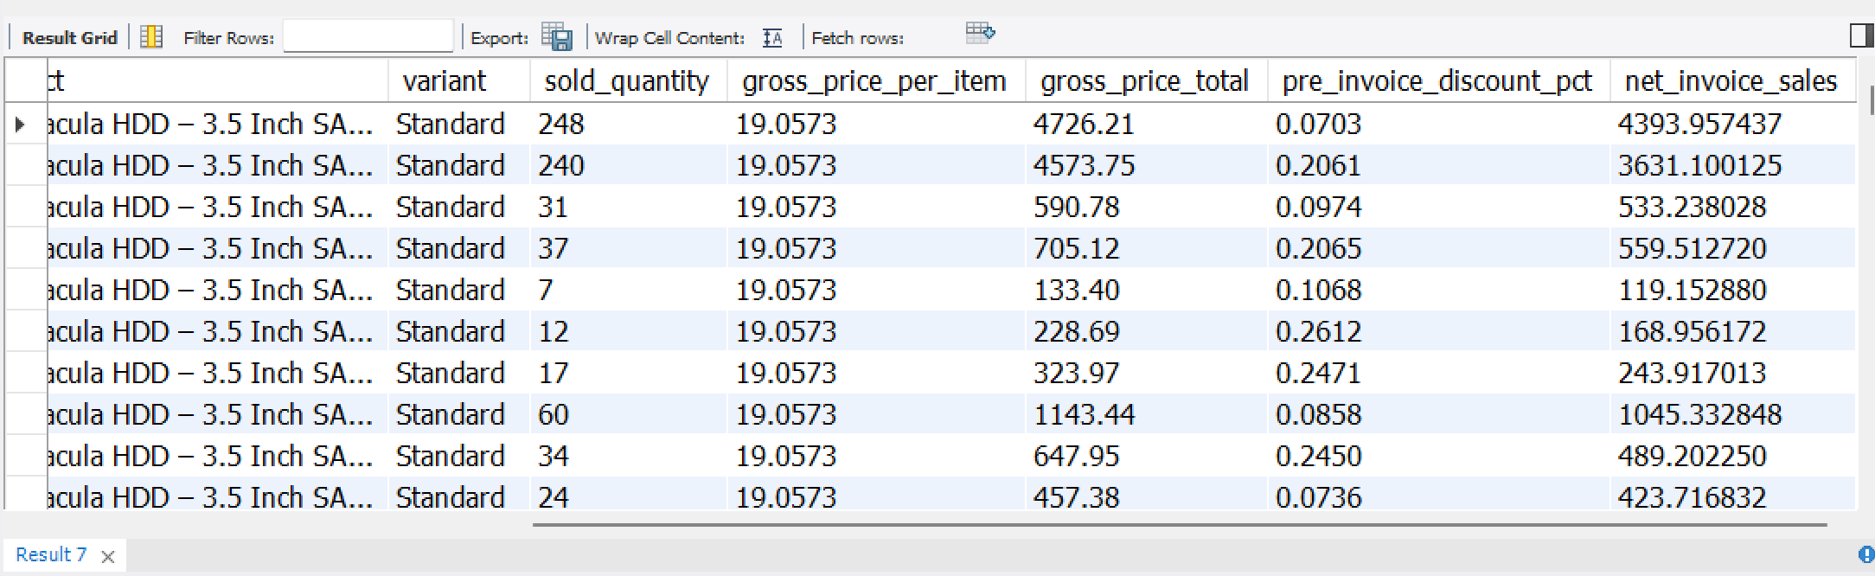
❑Module: Database Views
Get the net_invoice_sales amount using the CTE’s
WITH cte1 AS (
SELECT
s.date,
s.customer_code,
s.product_code,
p.product, p.variant,
s.sold_quantity,
g.gross_price as gross_price_per_item,
ROUND(s.sold_quantity*g.gross_price,2) as gross_price_total,
pre.pre_invoice_discount_pct
FROM fact_sales_monthly s
JOIN dim_product p
ON s.product_code=p.product_code
JOIN fact_gross_price g
ON g.fiscal_year=s.fiscal_year
AND g.product_code=s.product_code
JOIN fact_pre_invoice_deductions as pre
ON pre.customer_code = s.customer_code AND
pre.fiscal_year=s.fiscal_year WHERE s.fiscal_year=2021)
SELECT
*,
(gross_price_total
pre_invoice_discount_pct*gross_price_total) as net_invoice_sales
FROM cte1

Slide 21
Creating the view `sales_preinv_discount` and store all the data in like a virtual table
CREATE VIEW `sales_preinv_discount` AS
SELECT
s.date,
s.fiscal_year,
s.customer_code,
c.market,
s.product_code,
p.product,
p.variant,
s.sold_quantity,
g.gross_price as gross_price_per_item,
ROUND(s.sold_quantity*g.gross_price,2) as gross_price_total,
pre.pre_invoice_discount_pct
FROM fact_sales_monthly s
JOIN dim_customer c
ON s.customer_code = c.customer_code
JOIN dim_product p
ON s.product_code=p.product_code
JOIN fact_gross_price ON g.fiscal_year=s.fiscal_year
AND g.product_code=s.product_code
JOIN fact_pre_invoice_deductions as pre ON pre.customer_code = s.customer_code AND pre.fiscal_year=s.fiscal_year

Slide 22
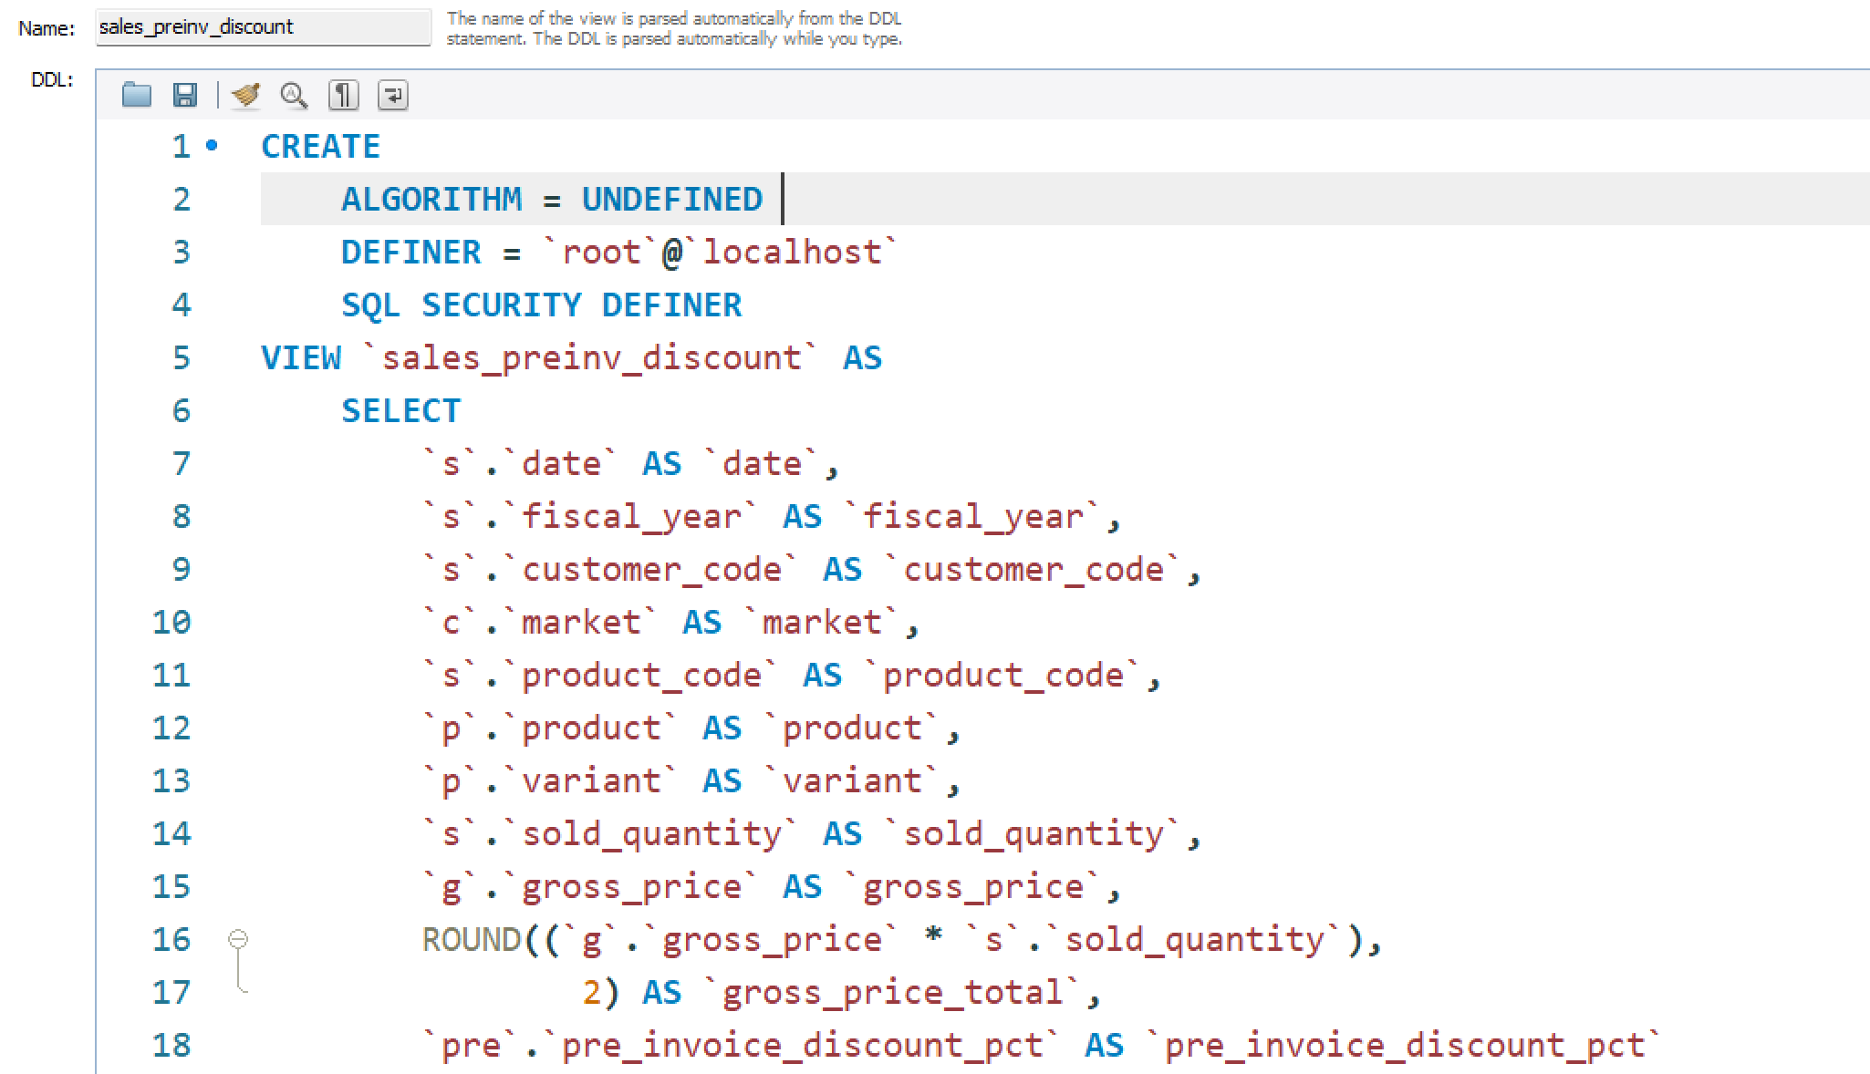
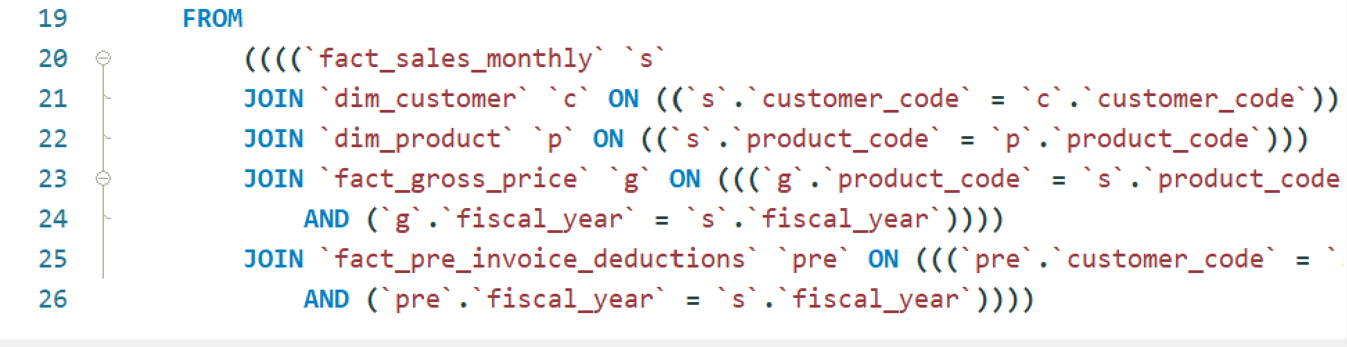

Slide 23
❑Module: Database Views: Post Invoice Discount, Net Sales
Create a view for post invoice deductions: `sales_postinv_discount`
CREATE VIEW `sales_postinv_discount` AS
SELECT
s.date, s.fiscal_year,
s.customer_code, s.market,
s.product_code, s.product, s.variant,
s.sold_quantity, s.gross_price_total,
s.pre_invoice_discount_pct,
(s.gross_price_total-s.pre_invoice_discount_pct*s.gross_price_total) as net_invoice_sales,
(po.discounts_pct+po.other_deductions_pct) as post_invoice_discount_pct
FROM sales_preinv_discount s
JOIN fact_post_invoice_deductions po
ON po.customer_code = s.customer_code AND po.product_code = s.product_code AND
po.date = s.date;

Slide 24
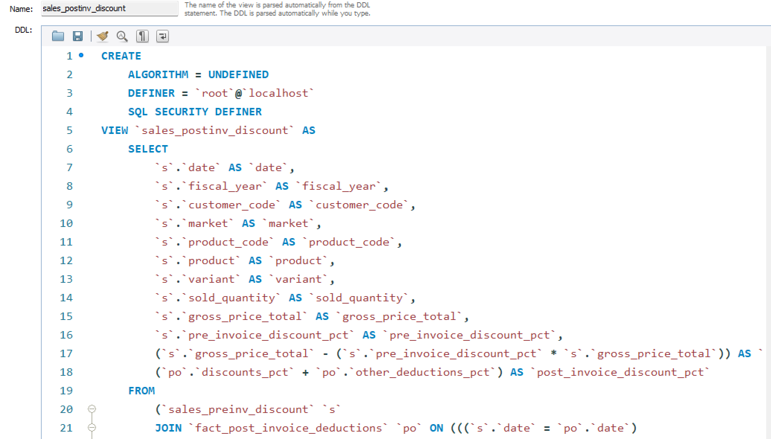

Slide 25
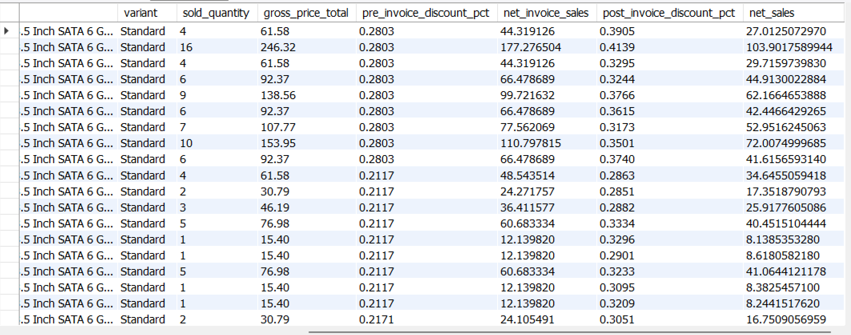
➢ Create a report for net sales
SELECT
*,
net_invoice_sales*(1-post_invoice_discount_pct) as net_sales
FROM gdb0041.sales_postinv_discount;
-- Finally creating the view `net_sales` which inbuiltly use/include all the previous created view and gives
the final result
CREATE VIEW `net_sales` AS
SELECT
*,
net_invoice_sales*(1-post_invoice_discount_pct)
as net_sales
FROM gdb0041.sales_postinv_discount;

Slide 26
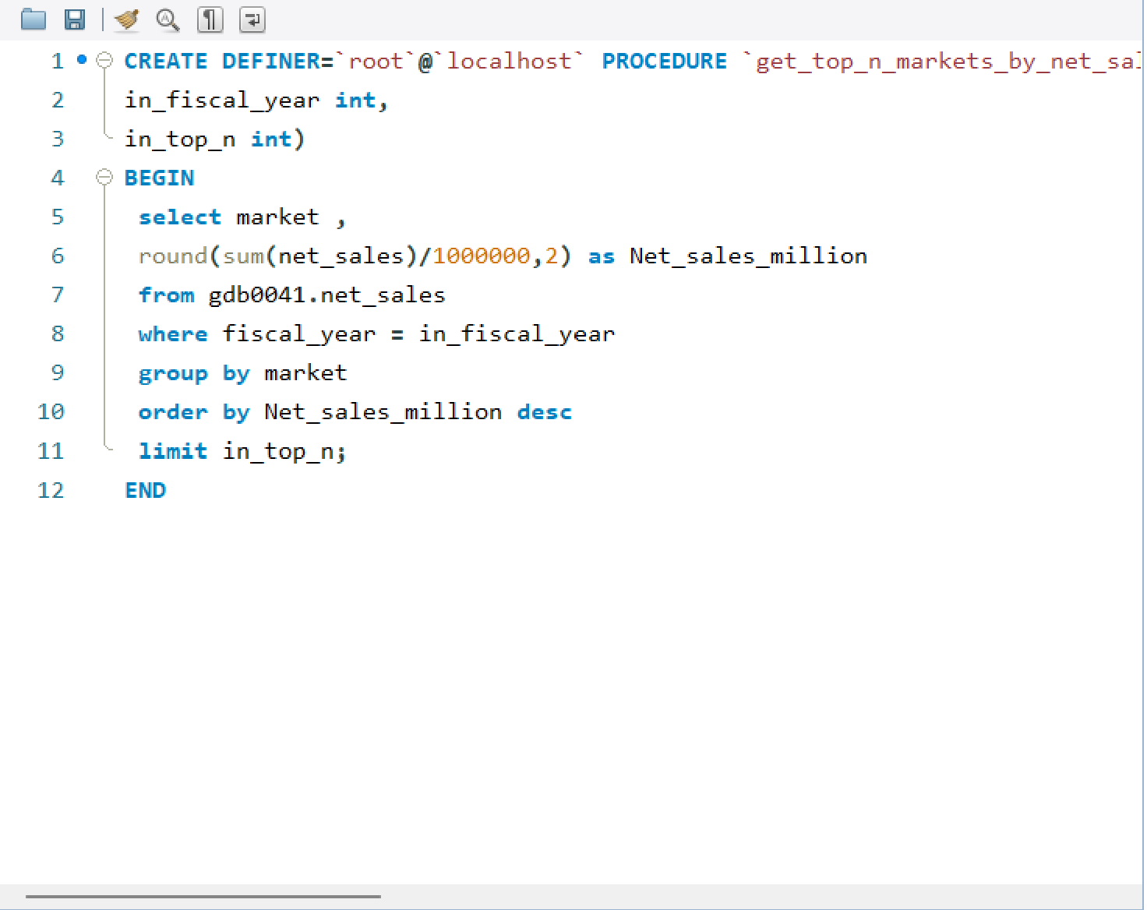
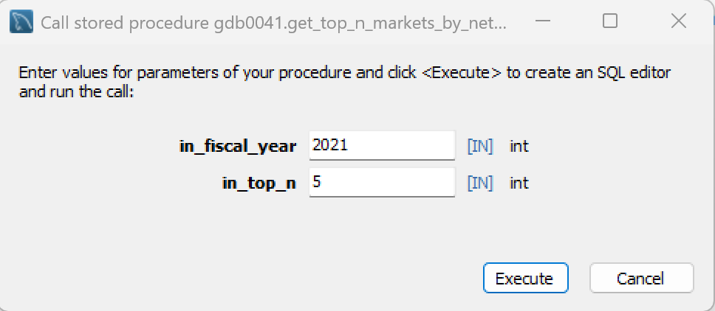
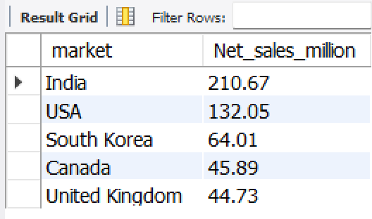
➢ Stored proc to get top n markets by net sales for a given year

Slide 27
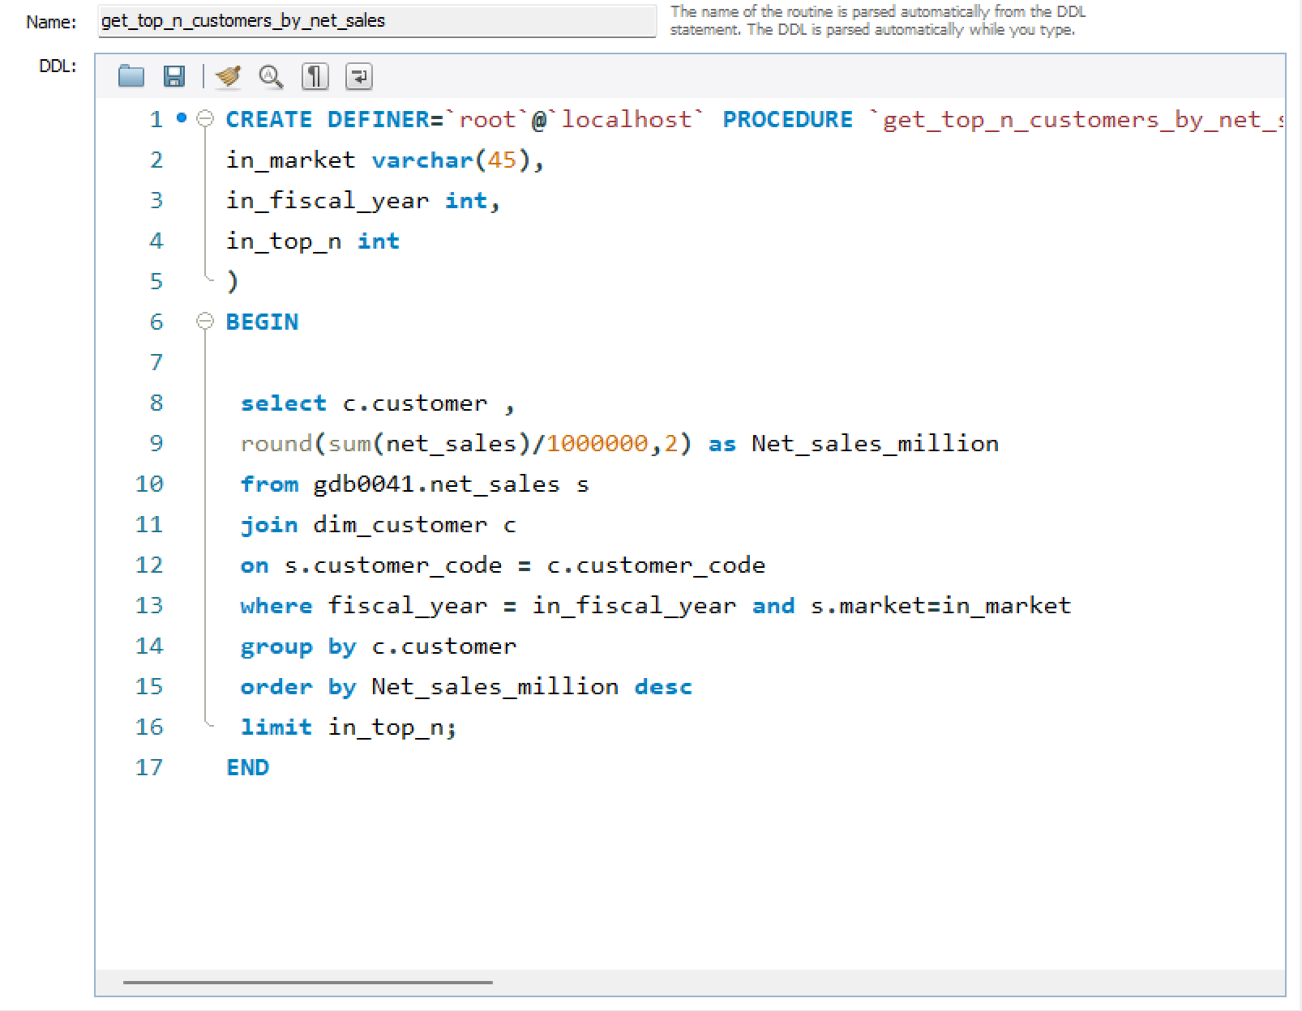
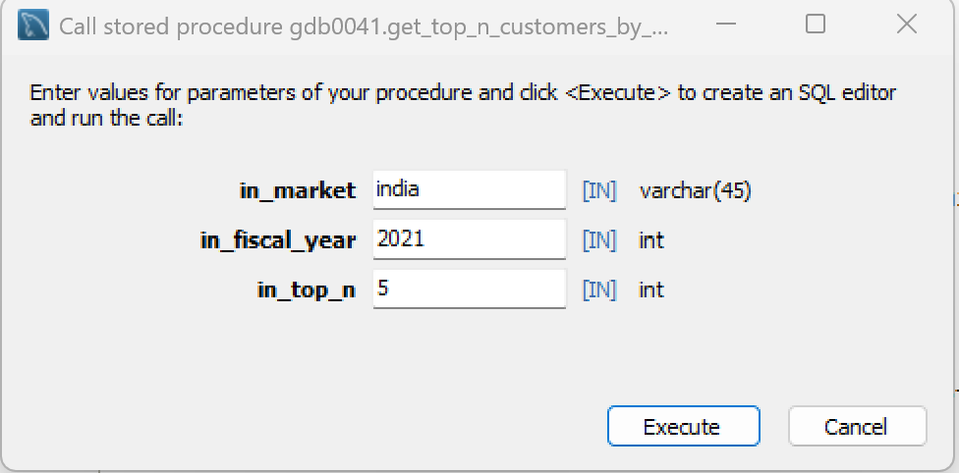
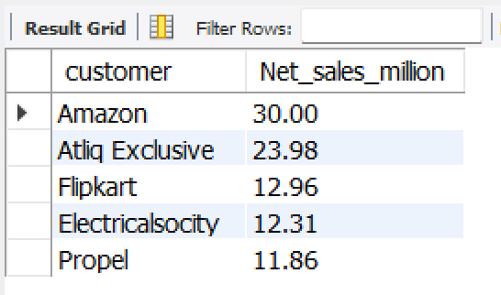
➢ stored procedure that takes market, fiscal_year and top n as an input and returns Top n customers by net
sales in that given fiscal year and market.
CREATE PROCEDURE `get_top_n_customers_by_net_sales`(
in_market VARCHAR(45),
in_fiscal_year INT,
in_top_n INT
)
BEGIN
select
customer,
round(sum(net_sales)/1000000,2) as net_sales_mln
from net_sales s
join dim_customer c
on s.customer_code=c.customer_code
where
s.fiscal_year=in_fiscal_year
and s.market=in_market
group by customer
order by net_sales_mln desc
limit in_top_n;
END

Slide 28
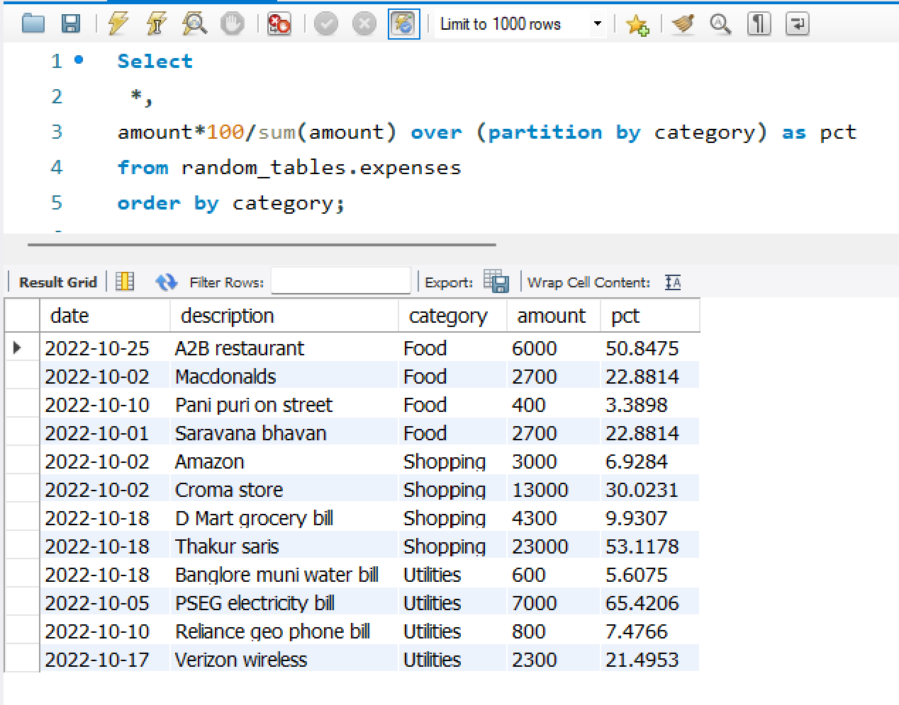
➢ Module: Window Functions: OVER Clause
show % of total expense per category

Slide 29
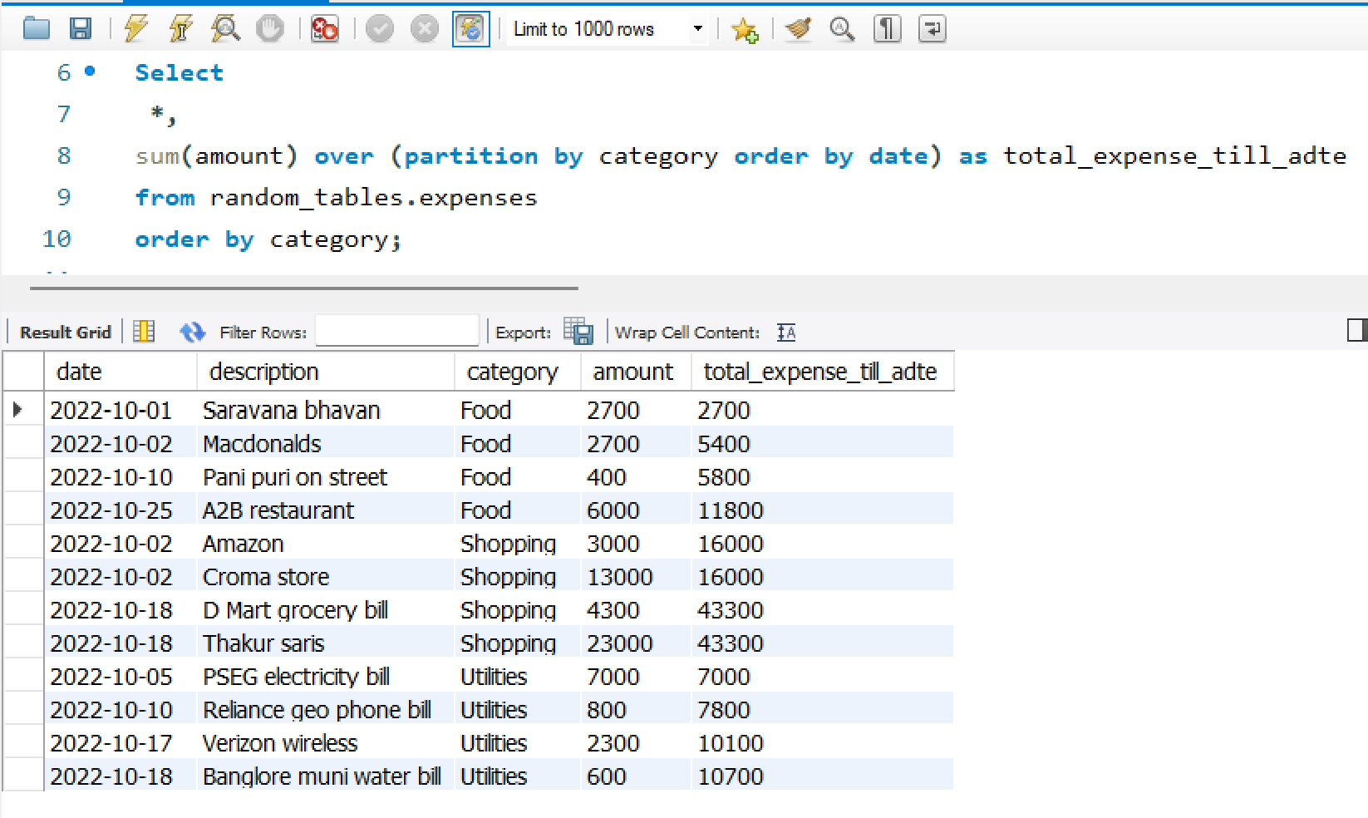
➢ Show expenses per category till date

Slide 30
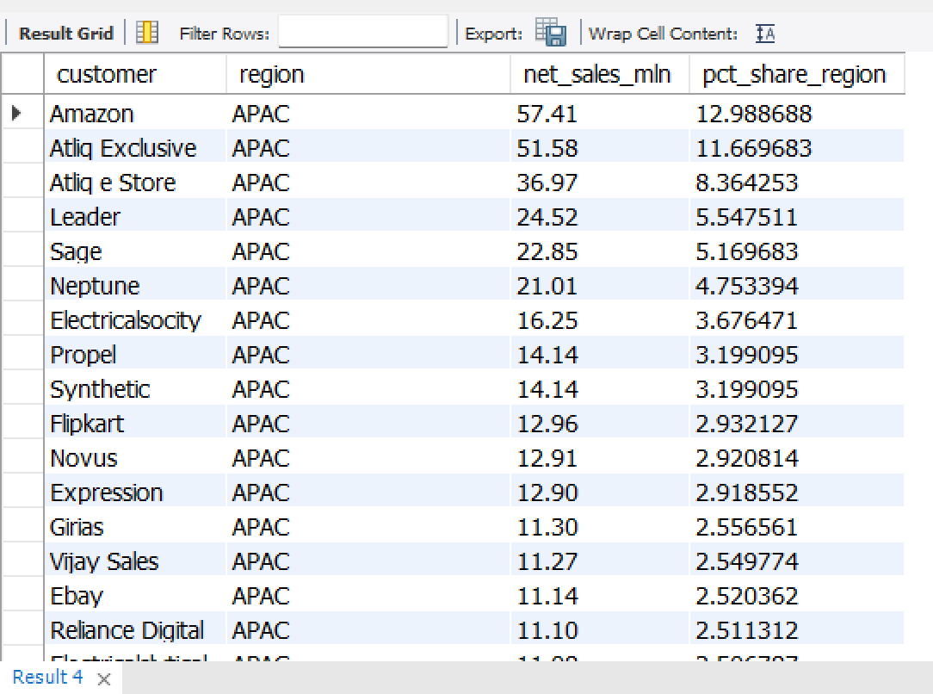
❑ Module: Window Functions: OVER Clause
Find customer wise net sales distribution per region for FY 2021.
with cte1 as (
select
c.customer,
c.region,
round(sum(net_sales)/1000000,2) as net_sales_mln
from gdb0041.net_sales n
join dim_customer c
on n.customer_code=c.customer_code
where fiscal_year=2021
group by c.customer, c.region)
select
*,
net_sales_mln*100/sum(net_sales_mln) over (partition by region)
as pct_share_region
from cte1
order by region, pct_share_region desc

Slide 31
❑Module: Window Functions: ROW_NUMBER, RANK, DENSE_RANK Find out top 3 products from each division by total quantity sold in a given year
with cte1 as
(select
p.division,
p.product,
sum(sold_quantity) as total_qty
from fact_sales_monthly s
join dim_product p
on p.product_code=s.product_code
where fiscal_year=2021
group by p.product),
cte2 as
(select
*,
dense_rank() over (partition by division order by total_qty desc) as drnk
from cte1)
select * from cte2 where drnk<=3

Slide 33
➢Creating stored procedure for the above query
CREATE PROCEDURE `get_top_n_products_per_division_by_qty_sold`(
in_fiscal_year INT,
in_top_n INT
)
BEGIN
with cte1 as (
select
p.division,
p.product,
sum(sold_quantity) as total_qty
from fact_sales_monthly s
join dim_product p
on p.product_code=s.product_code
where fiscal_year=in_fiscal_year
group by p.product),
cte2 as (
select *,
dense_rank() over (partition by division order by total_qty desc) as drnk
from cte1)
select * from cte2 where drnk <= in_top_n;
END

